Slide 1

Quantum-Safe Data Encryption for IoT Devices

Slide 2
Abstract
This internship project proposes following
Proposal to integrate LibOQS algorithms in Java frameworks for enhanced data security in PiltiSmart's IoT ecosystem.
Focus on combating quantum computing threats through post-quantum cryptography.
Selection and evaluation of NTRUEncrypt for IoT deployments.
Aims to establish a robust security protocol to ensure confidentiality, integrity, and authenticity of IoT data.
Utilization of Spring Boot for REST API integration to seamlessly incorporate cryptographic functionalities.
Goal is to foster trust among PiltiSmart's clientele by fortifying data security in IoT solutions.

Slide 3
Purpose
Objective:
Enhancing data security measures in response to escalating threats posed by quantum computing.
Importance of Post-Quantum Encryption:
Addressing Quantum Computing Threats: Traditional cryptographic algorithms are vulnerable to quantum attacks, which can compromise data confidentiality and integrity.
Future-Proofing Data Security: Adoption of post-quantum cryptographic algorithms ensures resilience against quantum computing threats, safeguarding sensitive IoT data in the long term.
Dangers of Not Using Post-Quantum Encryption:
Data Vulnerability: Without post-quantum encryption, IoT data transmitted over networks is susceptible to interception and decryption by quantum adversaries, leading to privacy breaches and data manipulation.
Reputation Damage: Security breaches resulting from inadequate encryption measures can tarnish PiltiSmart's reputation, eroding customer trust and confidence in its IoT solutions.
Goals:
Explore, implement, and evaluate post-quantum cryptographic algorithms provided by LibOQS.
Develop a comprehensive security protocol tailored for PiltiSmart's IoT ecosystem.
Establish trust and confidence among PiltiSmart's clientele by fortifying data security.

Slide 4
Existing System
In the current landscape of secure communication, RSA encryption stands as a widely adopted method for protecting sensitive data.
RSA encryption relies on the mathematical complexity of factoring large prime numbers, a task considered computationally infeasible for classical computers.
Unlike classical computers, quantum computers can quickly factor large numbers, undermining the security assumptions upon which RSA encryption is built.
For systems currently relying on RSA encryption for secure communication and data protection, the emergence of quantum computing presents a critical challenge.
The threat of quantum attacks underscores the importance of exploring alternative cryptographic solutions, such as post-quantum cryptography, to ensure the long-term security and resilience of existing systems.

Slide 5
Proposed System
In our proposed system, we are strategically integrating post-quantum encryption to fortify our data security measures against the imminent threats posed by quantum computing advancements. By harnessing advanced cryptographic techniques, we aim to create a robust defense mechanism that safeguards our sensitive information from potential breaches and unauthorized access.
Unlike RSA encryption, post-quantum cryptographic algorithms are designed to resist attacks from both classical and quantum computers.
Adoption of cutting-edge encryption algorithms resilient to quantum attacks, ensuring the confidentiality and integrity of our data.
Proactive stance in the realm of data security, positioning ourselves as leaders committed to staying ahead of emerging threats and protecting our stakeholders' interests.
Future-proofing our data infrastructure against evolving cyber threats by embracing innovative encryption methods and maintaining resilience in the face of uncertainty.

Slide 6
Hardware and Software Requirements
Hardware Requirements:
Quantum-Resistant Hardware: Evaluation of existing IoT devices to determine their compatibility with post-quantum cryptographic algorithms. Devices with sufficient computational resources and memory capabilities to support quantum-resistant algorithms like NTRUEncrypt
Quantum-Safe Hardware Implementation: Exploration of hardware-based security modules or dedicated cryptographic co-processors capable of executing quantum-resistant algorithms efficiently.
Software Requirements:
Java Development Environment: Installation of Java Development Kit (JDK) compatible with the selected Java-based frameworks for algorithm implementation and integration.
LibOQS Integration: Incorporation of LibOQS library into the development environment to access post-quantum cryptographic algorithms and functionalities.
Spring Boot Framework: Installation and configuration of Spring Boot framework for developing RESTful APIs, facilitating seamless integration of cryptographic functionalities into PiltiSmart's IoT ecosystem.
Compatibility Testing:
Compatibility Testing: Verification of compatibility between selected hardware and software components with the chosen post-quantum cryptographic algorithms.
Performance Evaluation: Benchmarking of algorithm performance on IoT devices to ensure optimal resource utilization and minimal computational overhead.

Slide 7
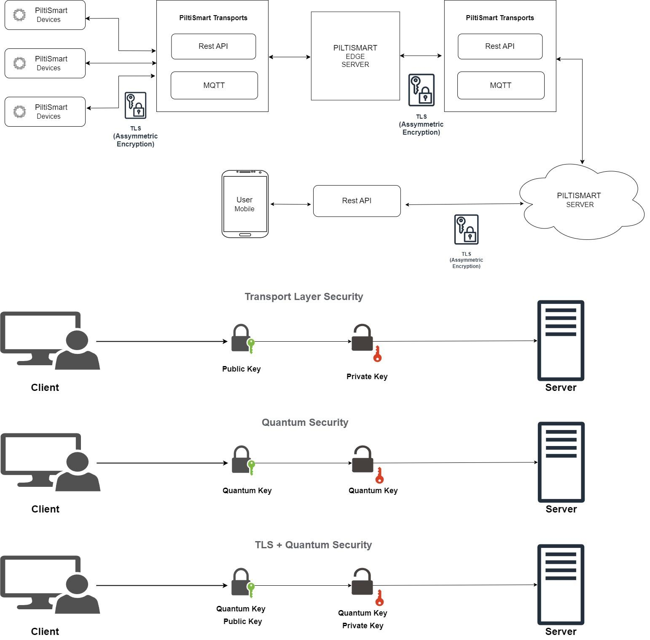
Data Flow Diagram

Slide 8
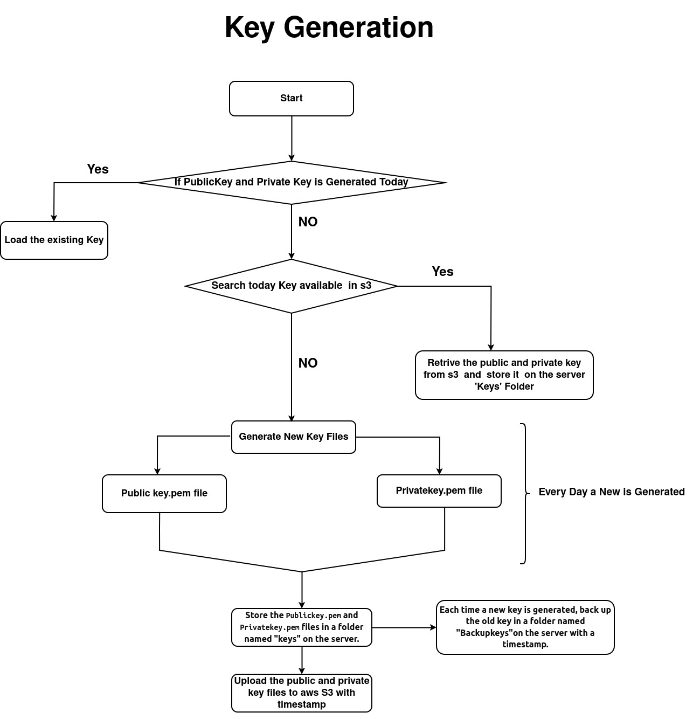

Slide 9
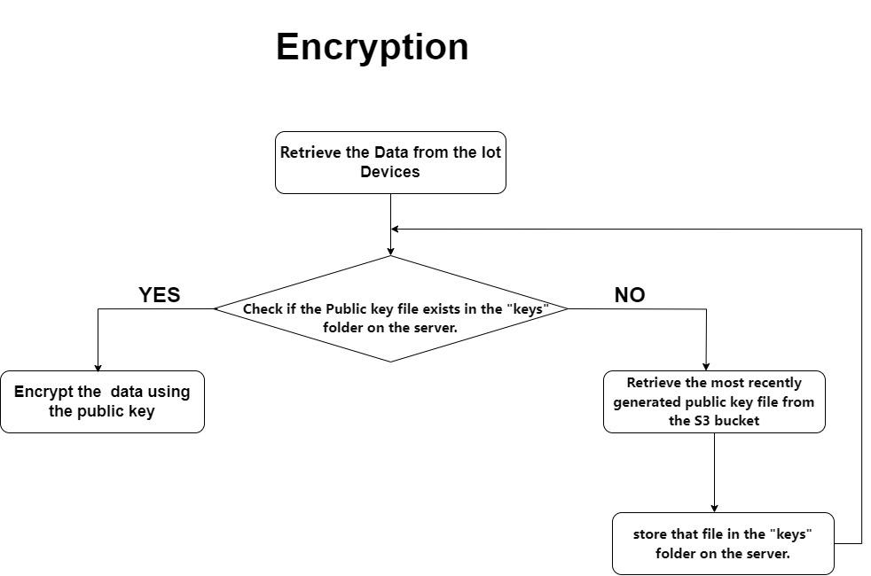

Slide 10
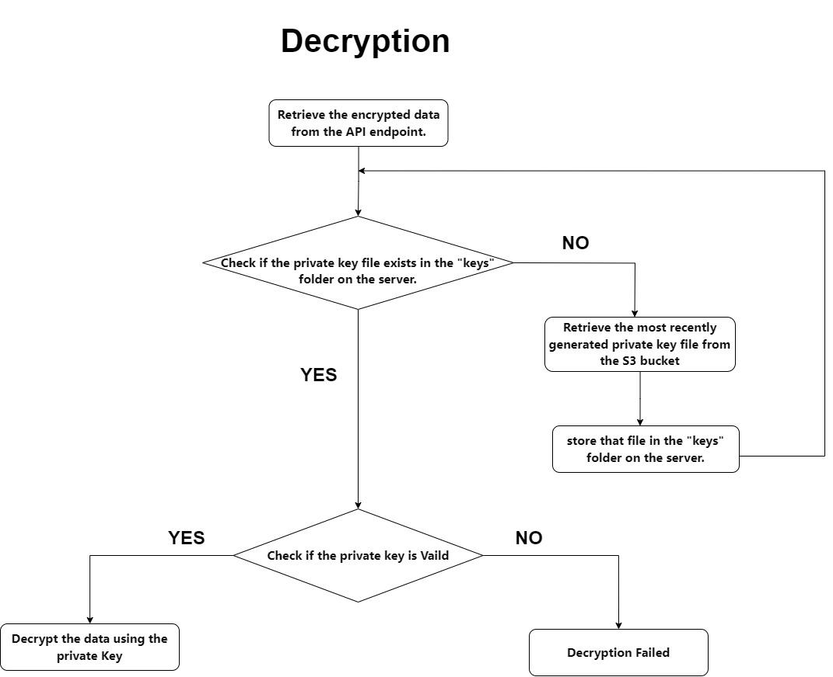

Slide 11
Modules / Stages
1 .NTRUEncrypt
Overview:
NTRUEncrypt is a lattice-based encryption scheme known for its efficiency and resilience against quantum attacks.
Key Features:
Offers strong security guarantees while maintaining relatively low computational overhead, making it suitable for resource-constrained IoT environments.
Suitability:
Assess NTRUEncrypt's suitability for IoT deployments based on its security strength, computational efficiency, and compatibility with PiltiSmart's infrastructure.

Slide 12
1. Ntru Key Generation
First, select general parameters for the system: N, p, and q. These parameters are not secret and can be known by everyone. For instance, N=251, q=128, and p=3 provide a standard security level.
Next, choose two random polynomials, f and g, with coefficients between -1 and 1, and a degree at most N-1. An example of such a polynomial could be -x³-x²+x-1.
The polynomial f∈Lf must satisfy the additional requirement that it has inverses modulo q and modulo p, which are computed using the Euclidean algorithm. This means that f⋅fp≡1(mod p) and f⋅fq≡1(mod q) must hold. If the chosen f is not invertible, Bob must try another f.
Then, compute the inverses fp of f (mod p) and fq of f (mod q). If any inverse doesn't exist, repeat the process with a different f until all inverses are found.
Finally, compute the number h using the given formula. This number, along with N, p, and q, forms the public key h=p⋅fq⋅g(mod q), which is shared with everyone.
The polynomials f, fp, and g constitute the private key, which must be kept secure.
For encryption, only the public key (h, N, p, q) is necessary, while the private key (f, fp, g) is used for decryption. This process ensures secure communication.

Slide 13
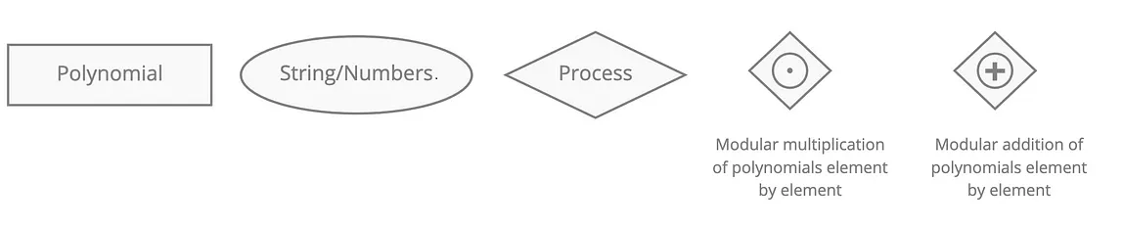
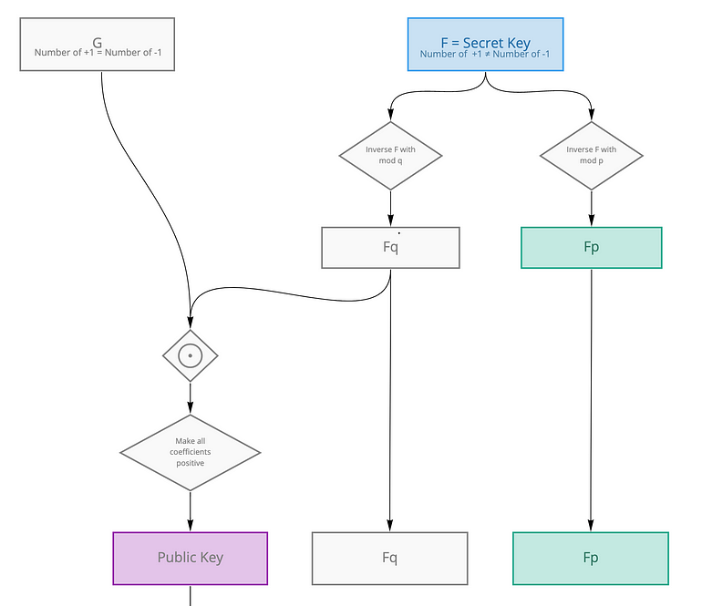
Key Generation flow

Slide 14
2. Public and Private Key File Generation
The Key File Generation module is a crucial component designed to handle the creation, storage, and retrieval of cryptographic keys, ensuring a fresh and secure set of public and private keys is available daily. The process begins with checking if today's keys already exist locally. If they are not found, the module searches for the keys in an AWS S3 bucket. If the keys are located in S3, they are downloaded and stored in the server's 'keys' folder. If the keys are not available locally or in S3, the module generates a new pair of keys.
Once new keys are generated, they are stored locally in the 'keys' folder. The module also incorporates a backup mechanism, where existing keys are moved to a backup folder with a timestamp to maintain a historical record. Additionally, the newly generated keys are uploaded to the AWS S3 bucket with a timestamp, ensuring they are securely stored and can be accessed when needed.
Overall, the Key Generation module enhances security by ensuring a new set of keys is available each day. The combination of local and cloud storage provides high reliability and availability, and the regular generation and backup of keys help meet regulatory and compliance requirements. This module ensures efficient and secure cryptographic key management, forming a reliable foundation for operations that require secure key usage.

Slide 15
3. Ntru Encryption
To encode a message for encryption, it needs to be converted into a polynomial. In this system, the encrypted message represents the amount of currency involved in a transaction.
This number is transformed into a polynomial with coefficients between -1 and 1. This transformation is achieved by converting the number into binary or ternary representation. For example, the number 13 becomes the polynomial x³+x²+1.
Once the polynomial representation of the message is obtained, a public key h is used. Additionally, a random polynomial called the Blinding Value, denoted as r, is chosen. This Blinding Value is crucial for encryption as it obscures the original message polynomial m. Without knowledge of the private key, decrypting the message becomes practically impossible. It's important to note that this Blinding Value differs for each encryption or transaction, enhancing security.
Formula for encryption e=r⋅h+m(modq)

Slide 16
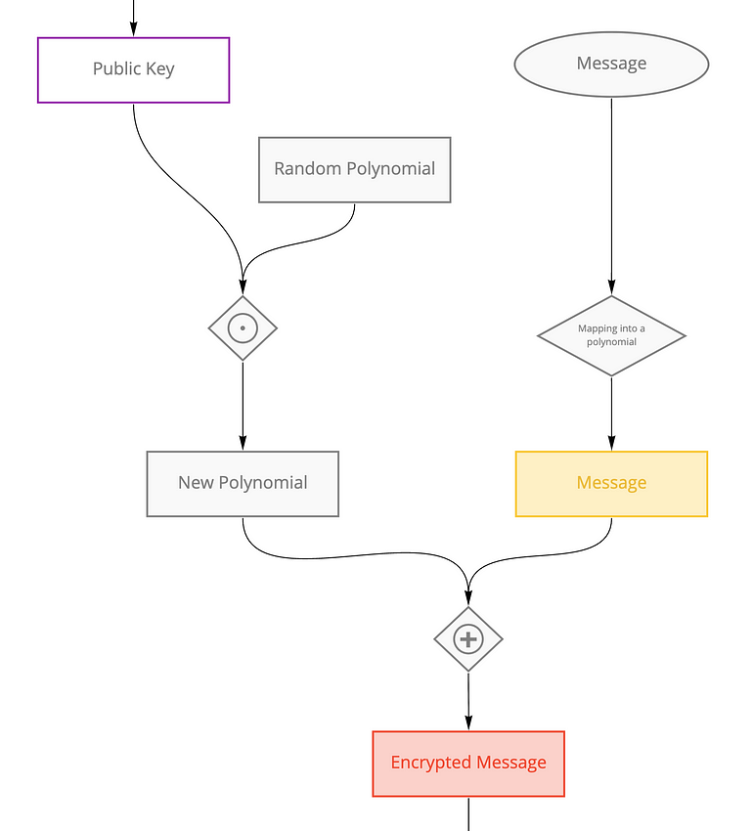
Ntru Encryption Flow

Slide 17
4. Data Encryption API Module
This module outlines the process of retrieving IoT device data via a Spring Boot API, separating the key and data, encrypting the data using the NTRUEncrypt algorithm, storing the encrypted data, and returning a response to the client.
The process begins when the API receives a POST request at the eg : /api/ntruencryptData endpoint containing the IoT device data in JSON format. Upon receiving the request, the API parses the JSON data to extract the key and data fields. The extracted data is then encrypted using the NTRUEncrypt algorithm, which involves retrieving the appropriate public key for encryption and applying the algorithm to securely transform the data into ciphertext.
Next, the encrypted data is securely stored in a database or other appropriate storage system, ensuring that the data is protected from unauthorized access and can be retrieved later as needed. After storing the encrypted data, the API prepares a JSON response containing the status of the operation and the encrypted data.
Finally, the API returns this JSON response to the client, concluding the process. This module ensures that IoT device data is securely encrypted and stored, providing robust protection against unauthorized access. Proper error handling and secure communication protocols, such as HTTPS, should be implemented to manage potential issues and ensure the security of data transmission between the client and the server.

Slide 18
5. NtruDecryption
Calculation of Polynomial a:
A polynomial a is computed by multiplying the received ciphertext e with a part of the private key f, followed by taking the result modulo q.
This ensures that the coefficients of a remain within a suitable range to prevent decryption issues.(a= f⋅e mod q)
Computation of Polynomial b:
The polynomial a obtained in the previous step is then reduced modulo p to yield another polynomial b.
This step prepares the polynomial for the subsequent decryption process by keeping its coefficients within a manageable range.(b= a mod p)
Utilization of Secret Polynomial fp​ for Message Retrieval:
Finally, another secret polynomial fp​, which serves as the inverse of a randomly chosen polynomial f, is employed to decrypt polynomial b.
Multiplying fp​ with b and taking the result modulo p yields the original message polynomial m. (m=fp​⋅b mod p)

Slide 19
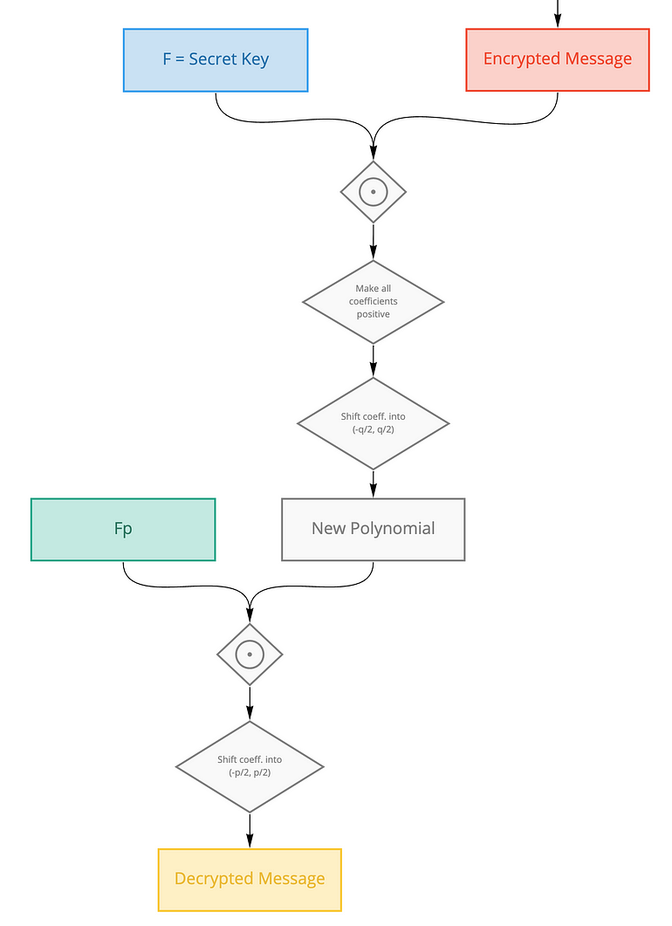
Ntru Decryption Flow

Slide 20
6. Data Decryption API Module
Decryption API for IoT Data addresses the critical need for decrypting data retrieved from ThingsBoard. This process starts with fetching encrypted data and its associated timestamp, understanding the JSON format which contains the keys and encrypted values. The timestamp is then extracted and used to determine the date in Unix format.
Using this date, the appropriate decryption key is located and retrieved from an S3 bucket. The retrieved key is utilized to decrypt the encrypted data.
Timestamp handling involves extracting and interpreting the timestamp to determine the exact date in Unix format. Amazon S3 stores the decryption keys with a date-based naming allowing easy access based on the determined date from the timestamp.
The decryption mechanism employs the key fetched from S3 to decrypt the data. The implementation flow includes initiating data retrieval through an API call to ThingsBoard, extracting the timestamp, determining the date, retrieving the key from S3, decrypting the data, and outputting the decrypted data for downstream processes. Error handling is an integral part of this process, addressing data retrieval errors, timestamp parsing errors, key retrieval errors, and decryption errors.

Slide 21
7.Authorization with JWT
The Authorization Module is a critical component of the security infrastructure, starting with the user login process. When a user logs in, their provided username and password are authenticated against the system's database or identity provider, ensuring that only authorized users gain access.
Upon successful verification, the system generates a JSON Web Token (JWT) with a short expiration time, typically set around 2 minutes. This JWT contains vital information, including user identity, roles, and permissions, necessary for authorization purposes.
Once generated, the JWT is handed over to the user, who uses it as a credential to access the decryption service. However, to maintain a high level of security, the system continuously monitors the token's validity. If the token expires, the user is prompted to re-authenticate, generating a fresh token for continued access. When a decryption request is initiated, the system checks the validity and expiration of the Bearer X-Authorization JWT token included with the request. Only upon successful validation does the system proceed with the decryption process, utilizing appropriate keys or algorithms to decrypt the requested data securely.

Slide 22
Testing
Unit Testing
Ensure that each component of the encryption and decryption processes functions correctly and meets the specified requirements.
Verify the generation of both public and private keys.
Ensure that the blinding value varies with each encryption process to enhance security.
Ensure that the original message is accurately retrieved from the ciphertext.
Integration Testing
Encrypt a sample message using the public key and then decrypt it using the private key.
Confirm the decrypted message matches the original plaintext.
Test the REST API endpoints developed using Spring Boot.
Validate that the API correctly handles encryption and decryption requests.
Check the response times and error handling for various input scenarios.
Usability Testing
Test the usability of any front-end interfaces provided for encryption and decryption operations.
Ensure clear error messages and instructions for users.
Verify the clarity and completeness of documentation provided for developers and end-users.
Ensure all necessary steps for setup, usage, and troubleshooting are covered.

Slide 23
Conclusion
Our project has successfully demonstrated the integration of the NTRUEncrypt algorithm into PiltiSmart's IoT ecosystem, providing a robust solution to counteract quantum computing threats.
Key Generation: We have successfully generated valid public and private keys suitable for secure encryption and decryption. These keys adhere to the specified parameters, ensuring uniqueness and security.
Encryption: The encryption process effectively converts plaintext messages into ciphertexts. The use of a blinding value ensures that even the same plaintext, when encrypted multiple times, results in different ciphertexts, enhancing security.
Decryption: The decryption process reliably recovers the original plaintext from the ciphertext using the correct private key. This confirms the integrity and reliability of our decryption function.
End-to-End Process: Our integrated process of encrypting and decrypting messages consistently reproduces the original plaintext. This demonstrates the robustness and practical applicability of the system in real-world scenarios.
The successful implementation of NTRUEncrypt strengthens our defense against quantum computing threats, ensuring the confidentiality, integrity, and authenticity of IoT data. Moving forward, we are committed to further enhancing our security measures by integrating additional post-quantum cryptographic algorithms and continuously improving our systems to stay ahead of emerging threats.

Slide 24
Future Enhancement
Integration of Additional Algorithms: Incorporate advanced post-quantum cryptographic algorithms such as FrodoKEM and SPHINCS+ to further enhance security.
FrodoKEM: A lattice-based key encapsulation mechanism known for its strong security guarantees against quantum attacks.
SPHINCS+: A stateless hash-based signature scheme offering robustness and efficiency, providing an extra layer of security for authentication processes.
Algorithm Diversity: By integrating multiple algorithms, we increase the overall resilience of our encryption system against potential vulnerabilities.

Slide 25
Bibliography and References
Hoffstein, J., Pipher, J., & Silverman, J. H. (1998). NTRU: A Ring-Based Public Key Cryptosystem. Lecture Notes in Computer Science, 1462, 267-288.
NIST Post-Quantum Cryptography Project. (n.d.). National Institute of Standards and Technology. Retrieved from https://csrc.nist.gov/projects/post-quantum-cryptography
Alkim, E., Ducas, L., Pöppelmann, T., & Schwabe, P. (2016). Post-quantum Key Exchange - A New Hope. 25th USENIX Security Symposium (USENIX Security 16), 327-343.
Stebila, D., & Mosca, M. (2016). Post-Quantum Key Exchange for the Internet and the Open Quantum Safe Project. Selected Areas in Cryptography - SAC 2016, 14-37.
RSA Laboratories. (2023). Cryptographic Algorithms and Key Sizes for Long Term Security. Retrieved from https://www.rsa.com/en-us/cryptography/
Spring Boot Documentation. (n.d.). Retrieved from https://spring.io/projects/spring-boot
Stack Overflow. (n.d.). Retrieved from https://stackoverflow.com/
Medium. (n.d.). Articles on Post-Quantum Cryptography. Retrieved from https://medium.com/
YouTube. (n.d.). Educational Videos on Cryptography. Retrieved from https://youtube.com/
Raspberry Pi Foundation. (n.d.). Tutorials Retrieved from https://www.raspberrypi.org/

Slide 26
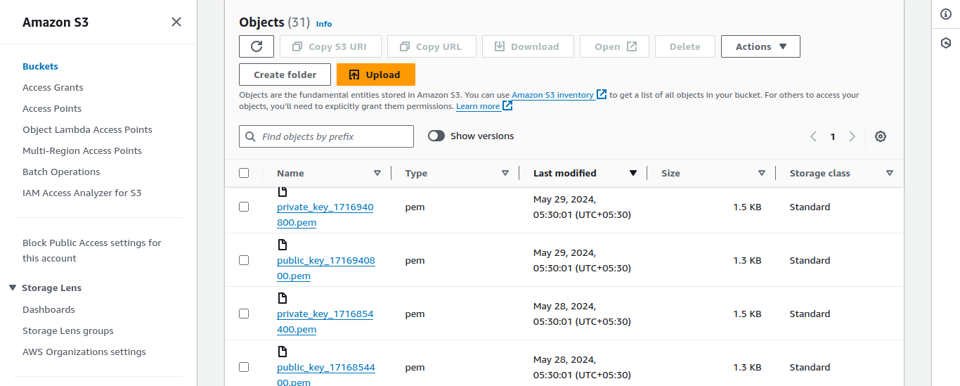
Storing Keys on Both Server and Amazon S3

Slide 27
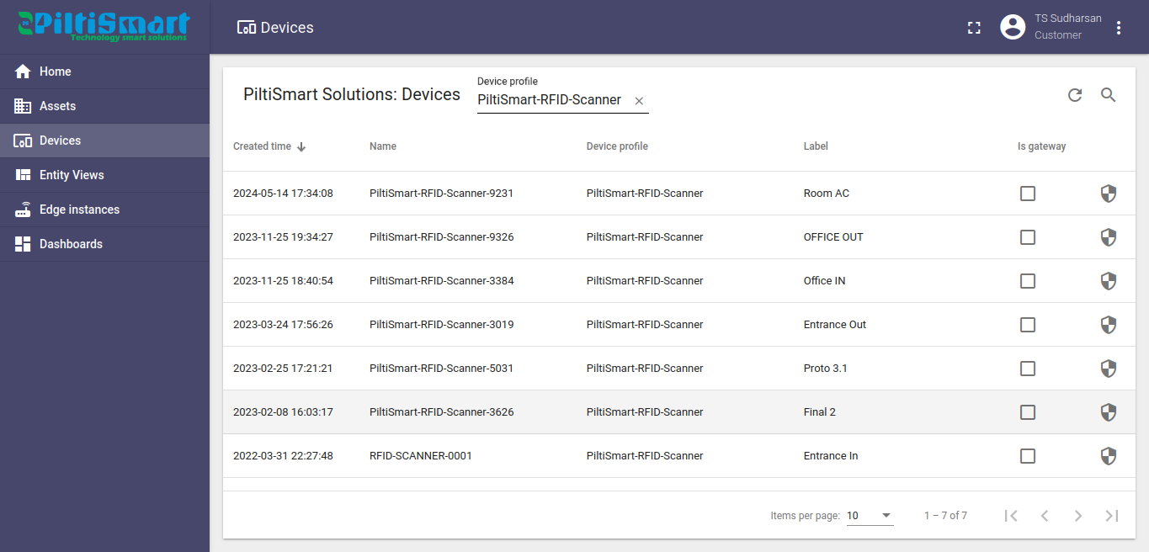
Piltismart Thinksboard UI (DEVICES)

Slide 28
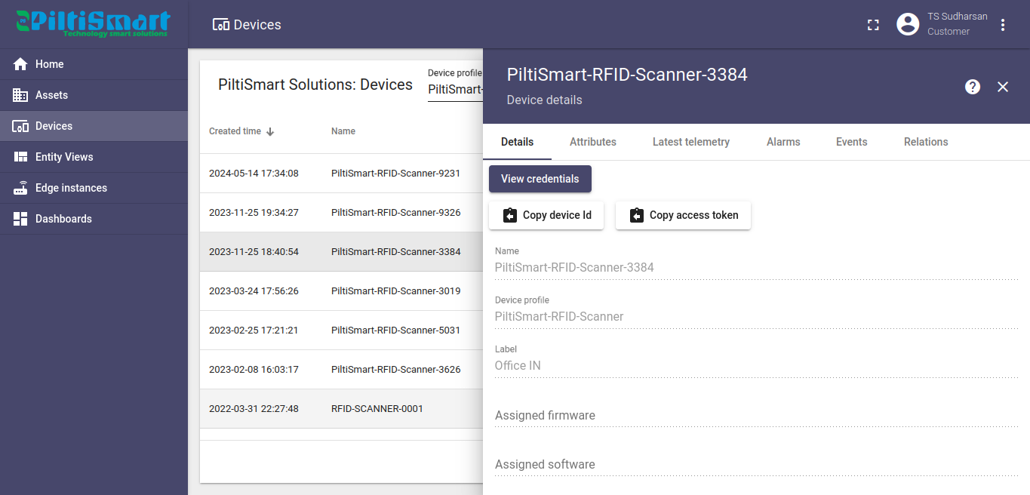
PiltiSmart Devices Details

Slide 29
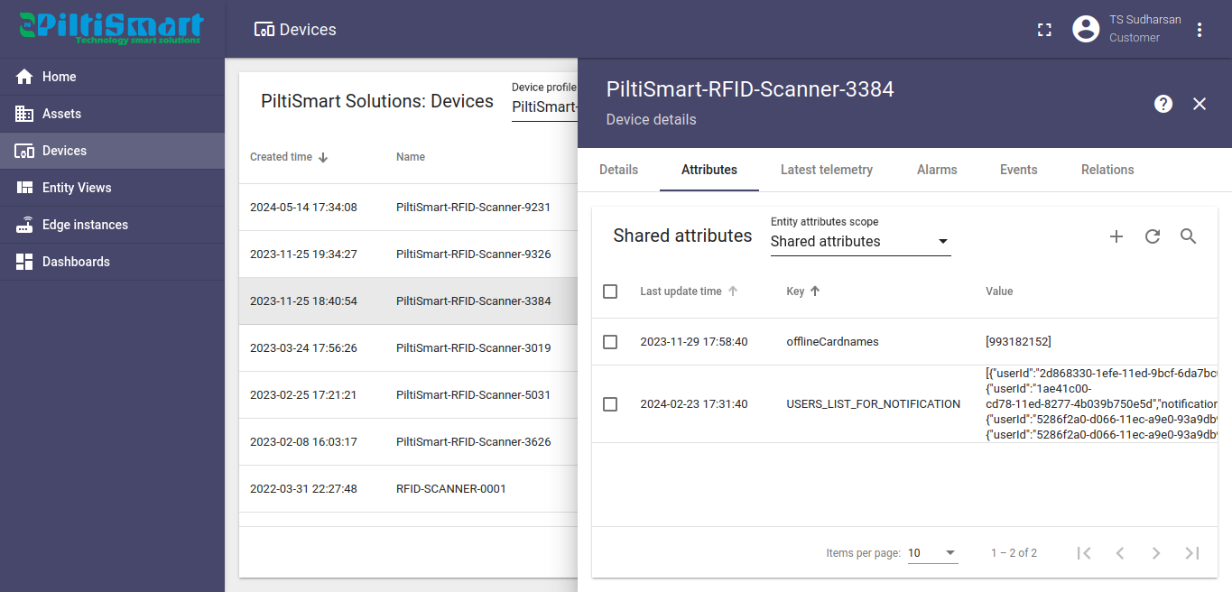
Device Data

Slide 30
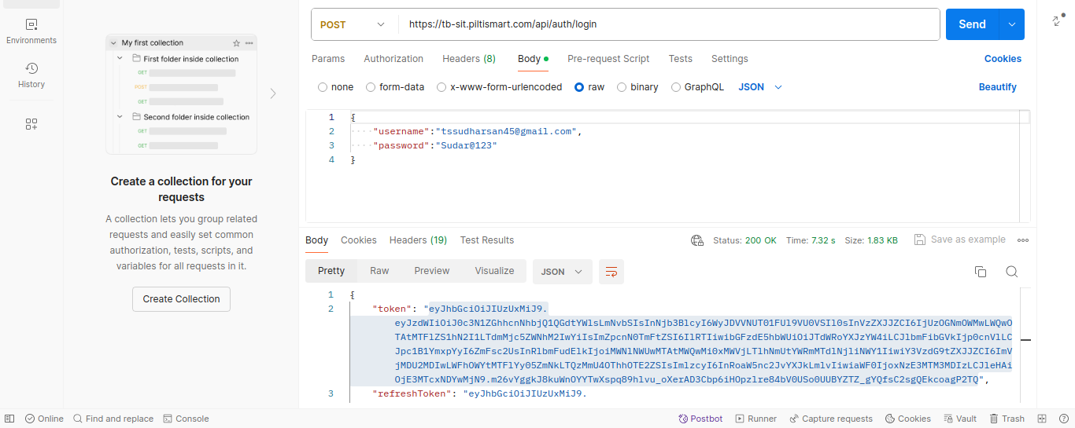
Authorization

Slide 31
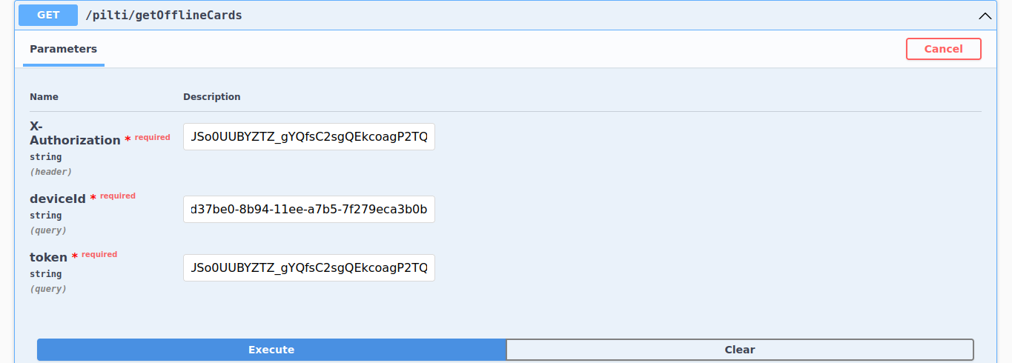
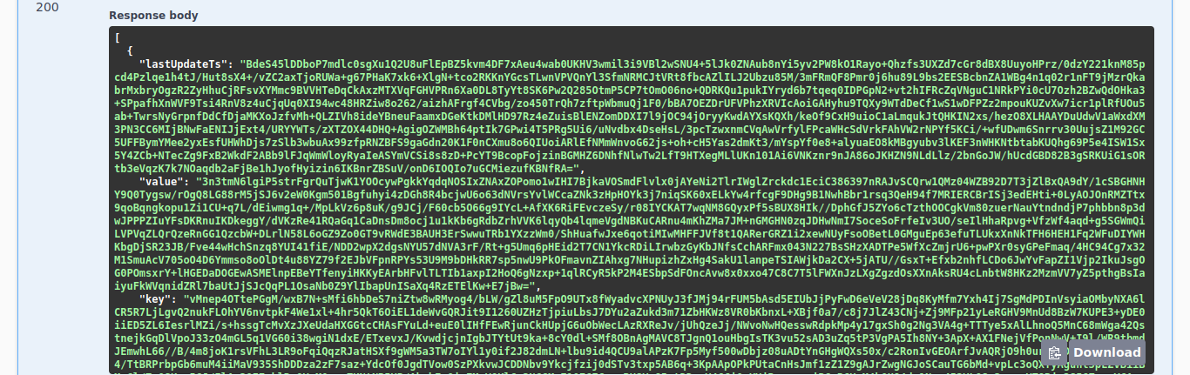
Encrypted Piltismart IoT Data with Ntru Using Public Key

Slide 32
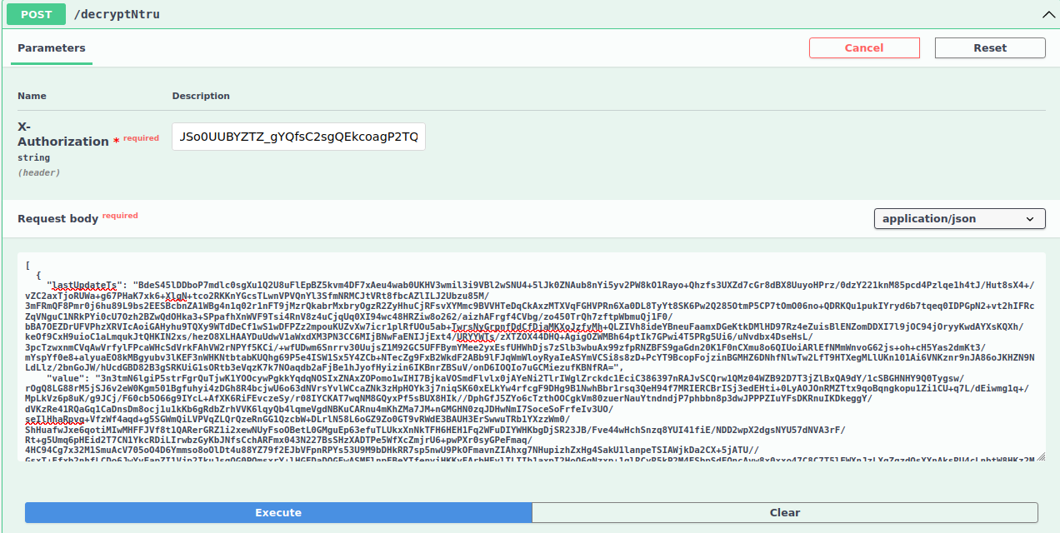
Endpoint For NtruDecryption Using Private Key

Slide 33
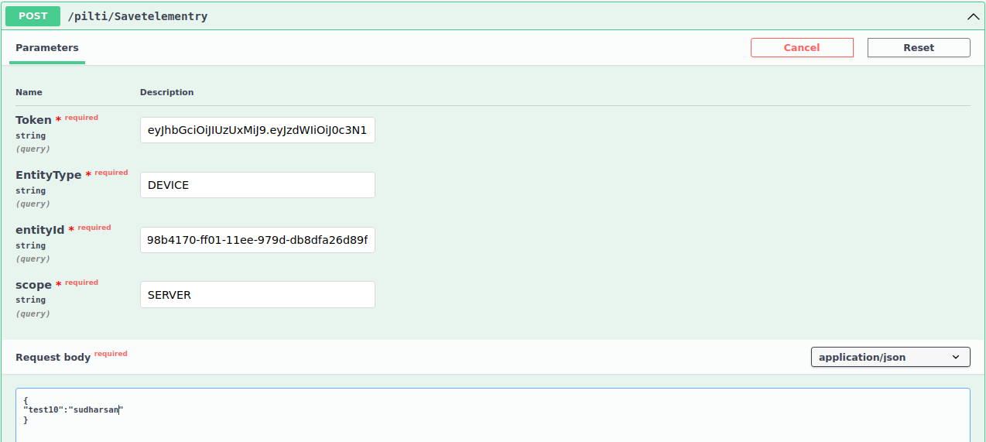
Send encrypted data to ThingsBoard while shipping

Slide 34
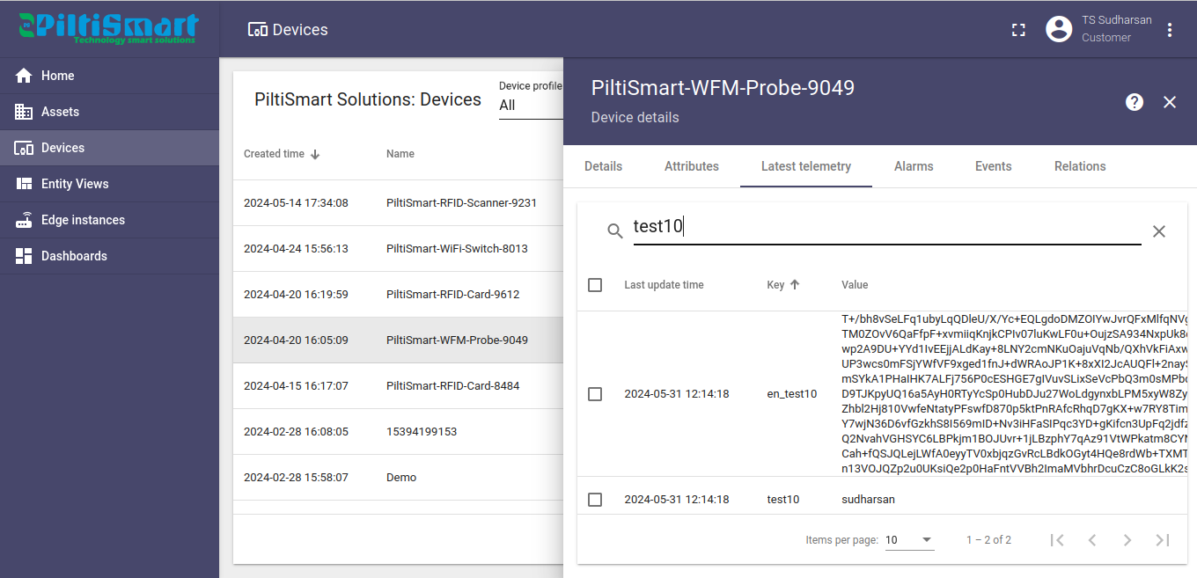
Data in Encryted Format

Slide 35
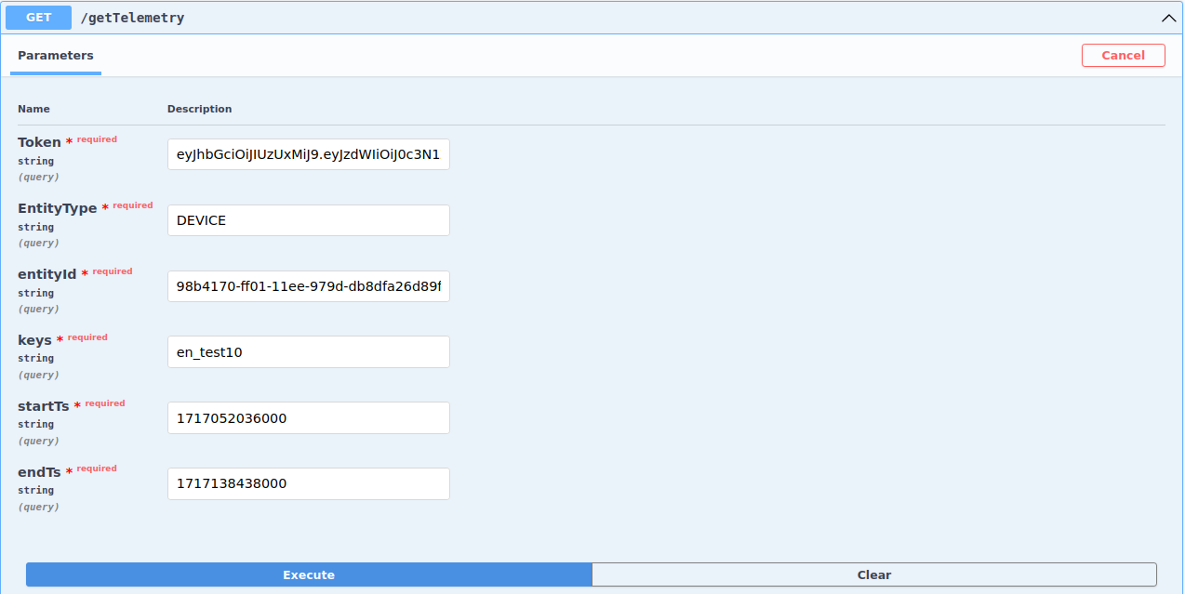
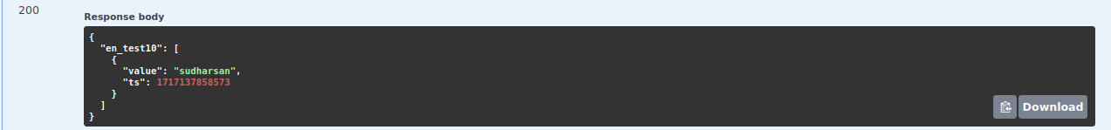
Decrypting Data from ThingsBoard

